Slide 1
IBM and Misa Canada(Ontario) Memorandum of Understanding and MRM V2 Workbench Pilot
December 1, 2010
Executive Steering Community Update (December 3, 2010)

Slide 2
MISA and IBM Status Update
Initial Proof of Technology
Sept 2009: IBM and MISA sign MoU (Sept 2009)
Nov – Mar 2010: Initial Proof of Technology (PoT) definition, build, config and evaluation
Apr-May: MISA MRM WG consolidate information on experience and challenges on the initial PoT
Jun-July: IBM Team evaluate workbench alternatives based on revised requirements
Aug: IBM presents 3 alternatives to the MISA MRM Working Group
MRM V2 Pilot
Sept: MISA Steering Committee agreed to proceed with the System Architect workbench
alternative
Sept - Nov: Joint IBM/MISA team (Skip & Jim) refine MRM V2 Meta Model and Workproduct List.
    IBM migrate previous PoT effort and develop new workproduct templates.
Dec - Jan: Propose Pilot with Region of Peel
    IBM to install the environment at eSolutions (Dec/10) including config environment and knowledge transfer (Dec/10)
    Region of Peel to execute the pilot (Dec/10-Jan/10)
Dec – Jan: Assess Governance alternatives and business models
Feb/2011: Pilot report back and go-forward strategy
Socialize Results
Jan 2011: Municipal Cloud update
Mar-May/2011:MRM V2 update to broader MISA Community?
April 2011: IBM Urban Information Symposium
June 2011: MISA (Ontario) and Lac Carling Canada events

Slide 3
Conceptual Model
Municipal
Reference
Model (MRM)
V2.?
Meta Model
Municipal
Reference Model (MRM) V2
Business Model V?
(Description of Program, Services, Resources & outcomes of a City/
Community)
My Municipal or
My Program
Business
Reference Model (s)
(Description of program,
Services, outcomes &
resources within selected
communities)
My Municipal or
My Program
Information &
Data Sources
(Variety of Data Sources
includes historical,
operational and real-time
MISA Business
Model
Workbench
(SW tools used to capture, model and visualize the business reference model (e.g. My Municipality)
MISA Strategy &
Planning
Workbench
(SW tools or scripts
used to support
Strategic and Operational
Planning by IT and City Planners)
MISA Community Collaboration & Asset Mngt
Workbench
(SW tools used to manage the models created by each municipality & other useful assets)
MISA Community
(Municipal)
Services
Workbench
(Future)
(Platform for the hosting and delivery
of shared services within a community (municipalities, , agencies, individuals & business)
Delivery Platform (Hosted SW and HW)
(Delivery platform to support strategy & planning services across
Municipalities & Communities)
(Future: Virtualized, Subscription Based, Usage Tracking, Provisioning)

Slide 4
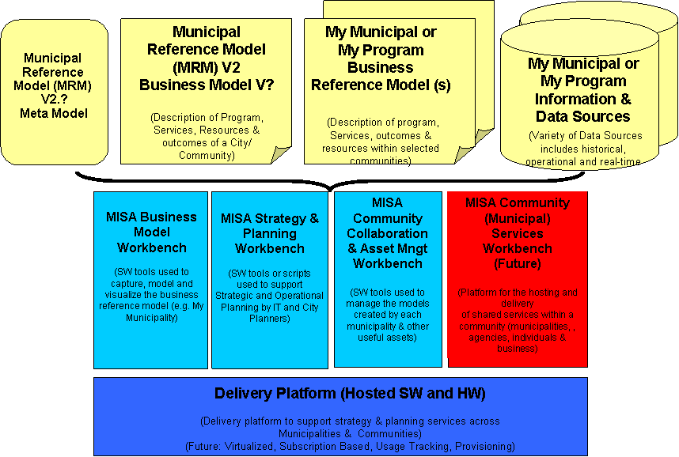
Conceptual Model
Baseline version of the Reference model? How manage changes?
Peel Program, Service etc. content?
Status of the Peel Test Script?
Support model during the pilot?
Baseline version of the Meta Model?
How manage changes?
Data sources
From Peel Pilot?
Evaluation licenses sent.
Training plan?
Collaboration
Environment?
Checkpoint meetings?
Date to set-up/config the environment?
2 phases as still working on some reports/templates
Guidelines for on-going support of the pilot?
Standard hosed environment.
Discussion on alternatives?

Slide 5
Governance Discussion
Proposed IBM Pilot (Peel) Project Team
  Canadian SmartCity/Public Sector Technical Executive: Alison Oleksiak
  Client Representative: TBC
  Project Lead: TBC
  Technical Lead: Jim Amsden
  Software Representative: Stephen Brickell
  Development & Support Team
Proposed Executive Team
  Canadian Software Lead: Doug Mester
  Rational Program Lead: Bruce Baron
  Canadian SmartCity/Public Sector Technical Executive: Alison Oleksiak
  Client Executive: TBC
  SmartCity Executive Architect Lead: Bob Dill
  SmartCity Industry Executive: Peter Williams

